Slide 1


Incline Village
2023 County
Accomplishments

Slide 2


2023
A year of laying the foundation
for generational change
within our community

Slide 3
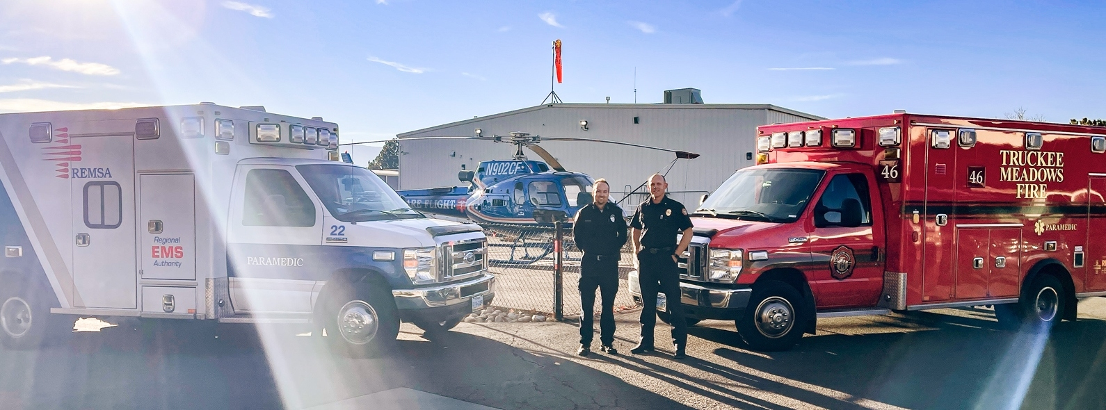
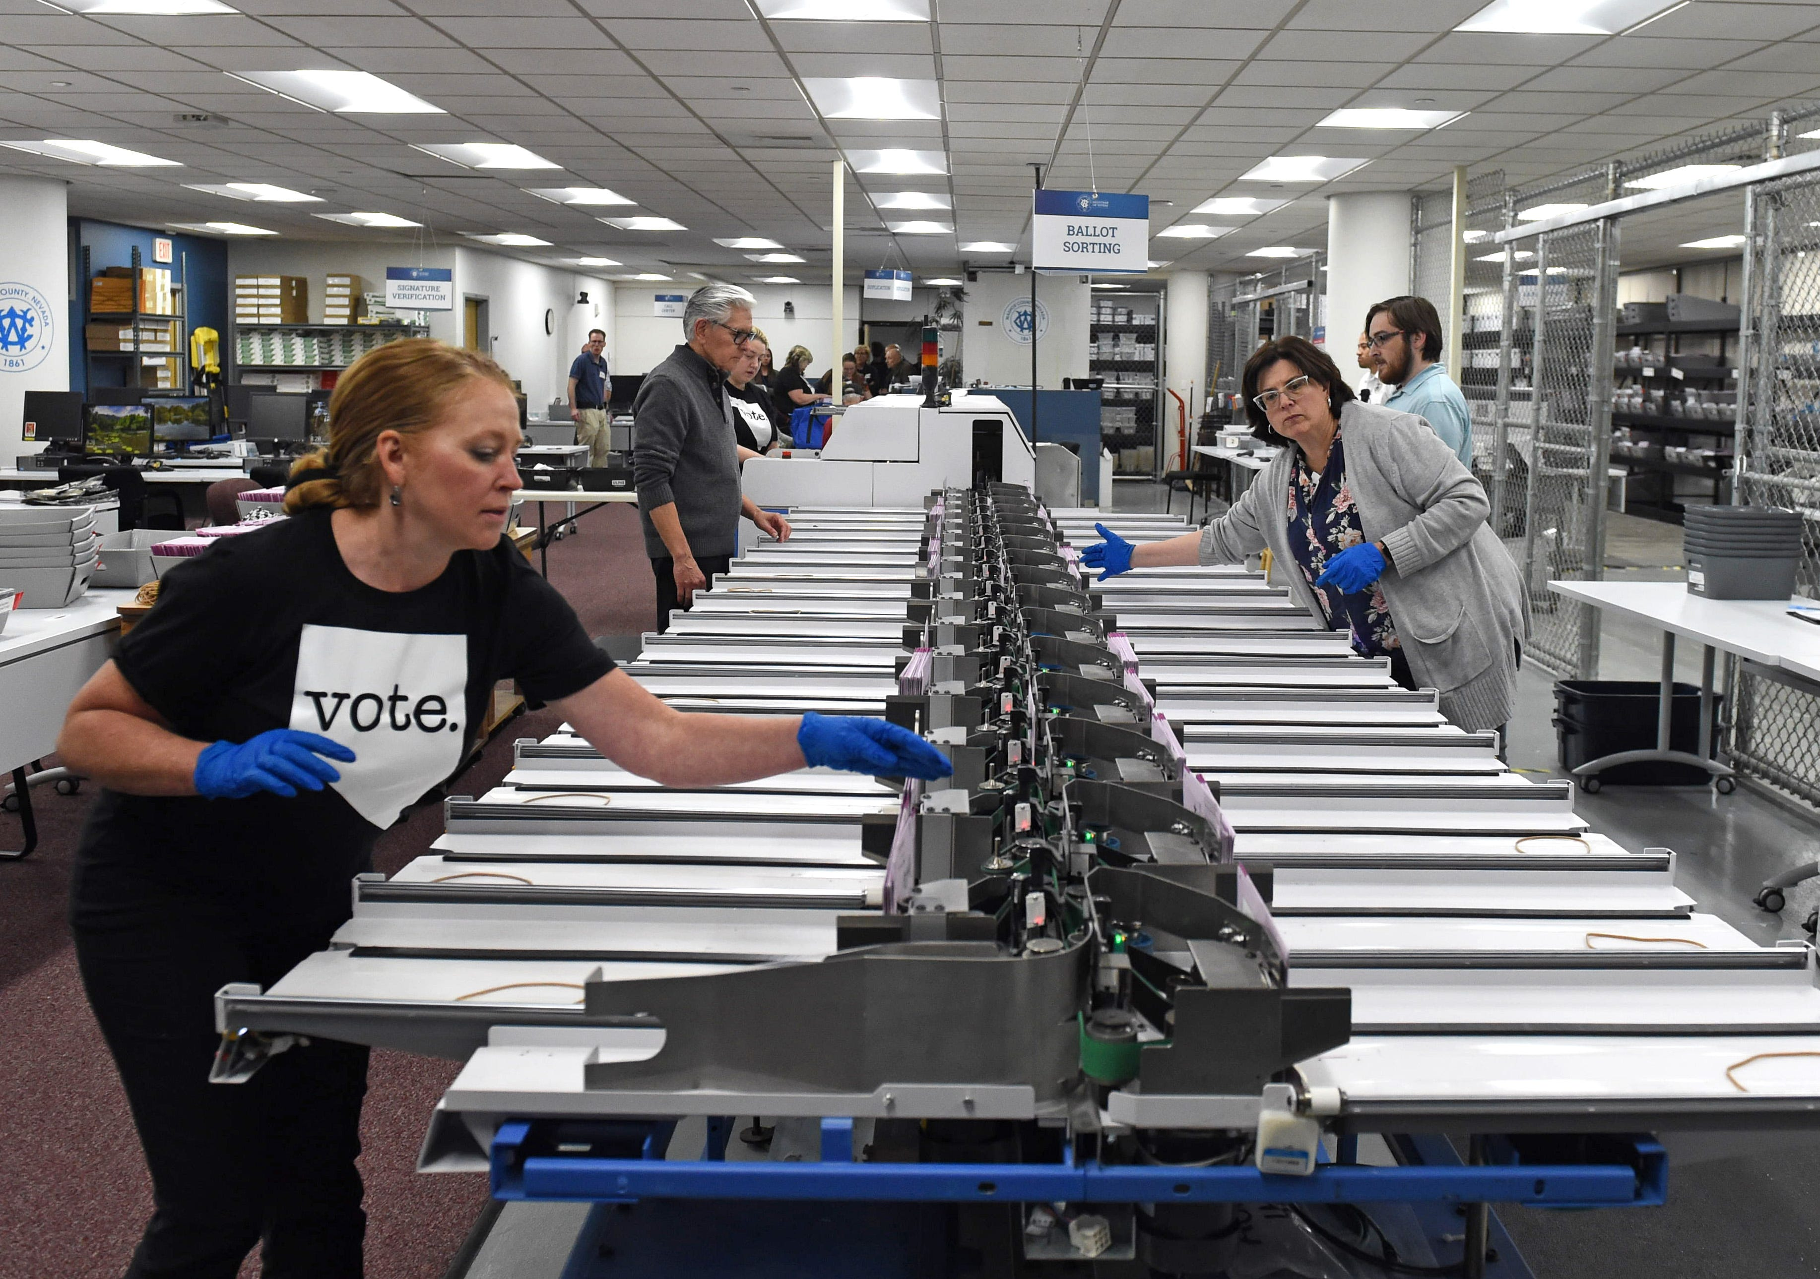

2023 Accomplishments
Regionalization of Dispatch/EMS/Fire
  Executed regionalized computer aided dispatch (CAD) platform ILA with Reno/Sparks/REMSA in September
  CAD implementation underway for target 24-month timeline
Improve Elections Administration/Execution
  Completed independent consultant review of ROV 2022 elections operations
  Implemented full staffing consistent with consultant recommendations
  Standard Operating Procedure (SOP) development underway for PPP
Launched Climate Resilience Initiative
  Hired Sustainability Manager
  Award-Winning Green Recovery Plan
  BCC accepted May presentation on planned priorities
  Secured Federal Sustainability Grants
Implemented Perimeter Emergency Evacuation Mapping Tool

Slide 4


Enhanced Community Outreach Efforts
Implemented SpeakUp with eComment services to extend public outreach capabilities for BCC meetings
Implemented remote BCC meeting participation for Incline Village and Gerlach communities
Developed and launched an online HUB documenting development activity and included development reviews at CAB meetings
Notes:
Narrate here – the "why" is critical.

Slide 5

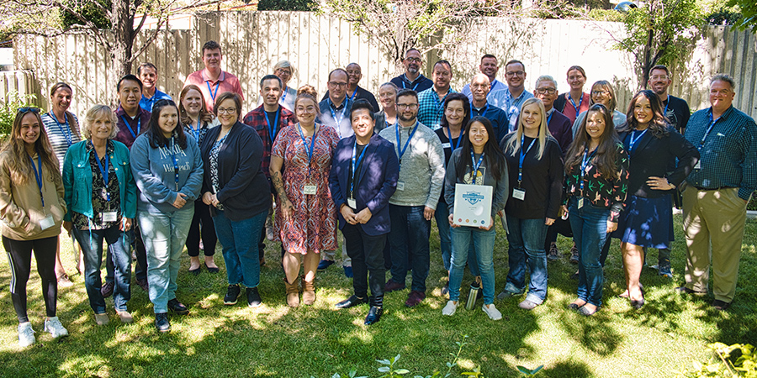
Enhanced Community Outreach Efforts
Washoe County Leadership Academy – Inaugural class complete and 2nd year underway
  Received 267 applications in year two, up from 180 in year one
  Increased curriculum by one full day, from 8 to 9 days
  Nine first-year alumni applications to boards and committees,
  with five appointed; one new hire
  Two class projects successfully completed in year one, with a single project
  for year two focused on foster and adoption
Conducted 99 public meetings (including CABs)
Facilitated 44 proclamations and recognitions
Resolved 253 escalated constituent requests out of 281 total
Resolved 280 commissioner requests out of 305 total
Notes:
Narrate here – the "why" is critical.

Slide 6

Washoe Tahoe Academy
Washoe Tahoe Academy
  Autumn of 2023, conducted survey specific to Incline Village & Crystal Bay residents to ascertain the appetite for a Tahoe-specific Academy
  109 participated, indicating a majority would prefer to pick and choose one-off topics to learn about, rather than be a part of a full series/cohort
  Desire for enhanced understanding of the various entities in the area and how they work together, i.e., TRPA, TTD and topic-specific workshops on items such as STRs, emergency preparedness, affordable housing discussions
  Strong desire to feel that Washoe County is listening to the needs and wants of residents of Washoe Tahoe and implementing policies accordingly – opportunity to promote board & committee openings to IVCB residents
Launching
Summer 2024
Notes:
Narrate here – the "why" is critical.

Slide 7
Strong Financial Management
Clean independent financial statement audit and compliance
Ended fiscal year 2023 with better-than-anticipated General Fund financial results
Award-winning accounting, financial reporting and budgeting
Expenditures continue to be less than budget
Accounting and Budget Management

Slide 8
Incline Village 2023 ARPA Investments
Incline High School Eng/Entrepreneurship | $ 50,000
Justice Court Renovations | $ 747,800
IVGID Recreation | $ 250,000
Tahoe Micro Transit Pilot Proj | $ 400,000
Tahoe Lending Locals Proj | $ 350,000
IVCB Mainstreet | $ 75,000
Envision Tahoe | $ 47,500
Tahoe Transportation – TTD | $ 37,500
Total | $1,957,800

Slide 9
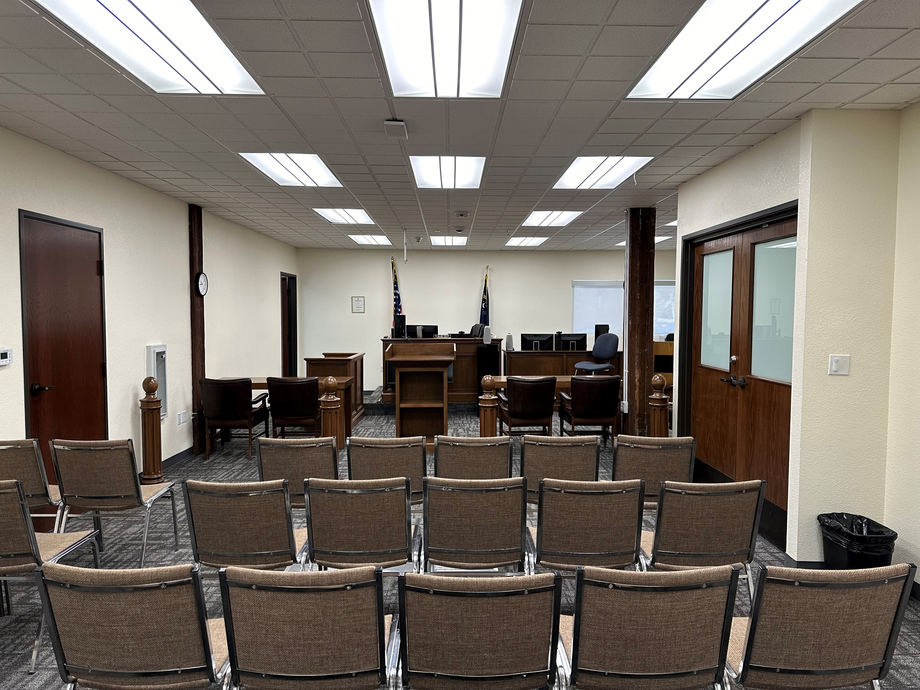
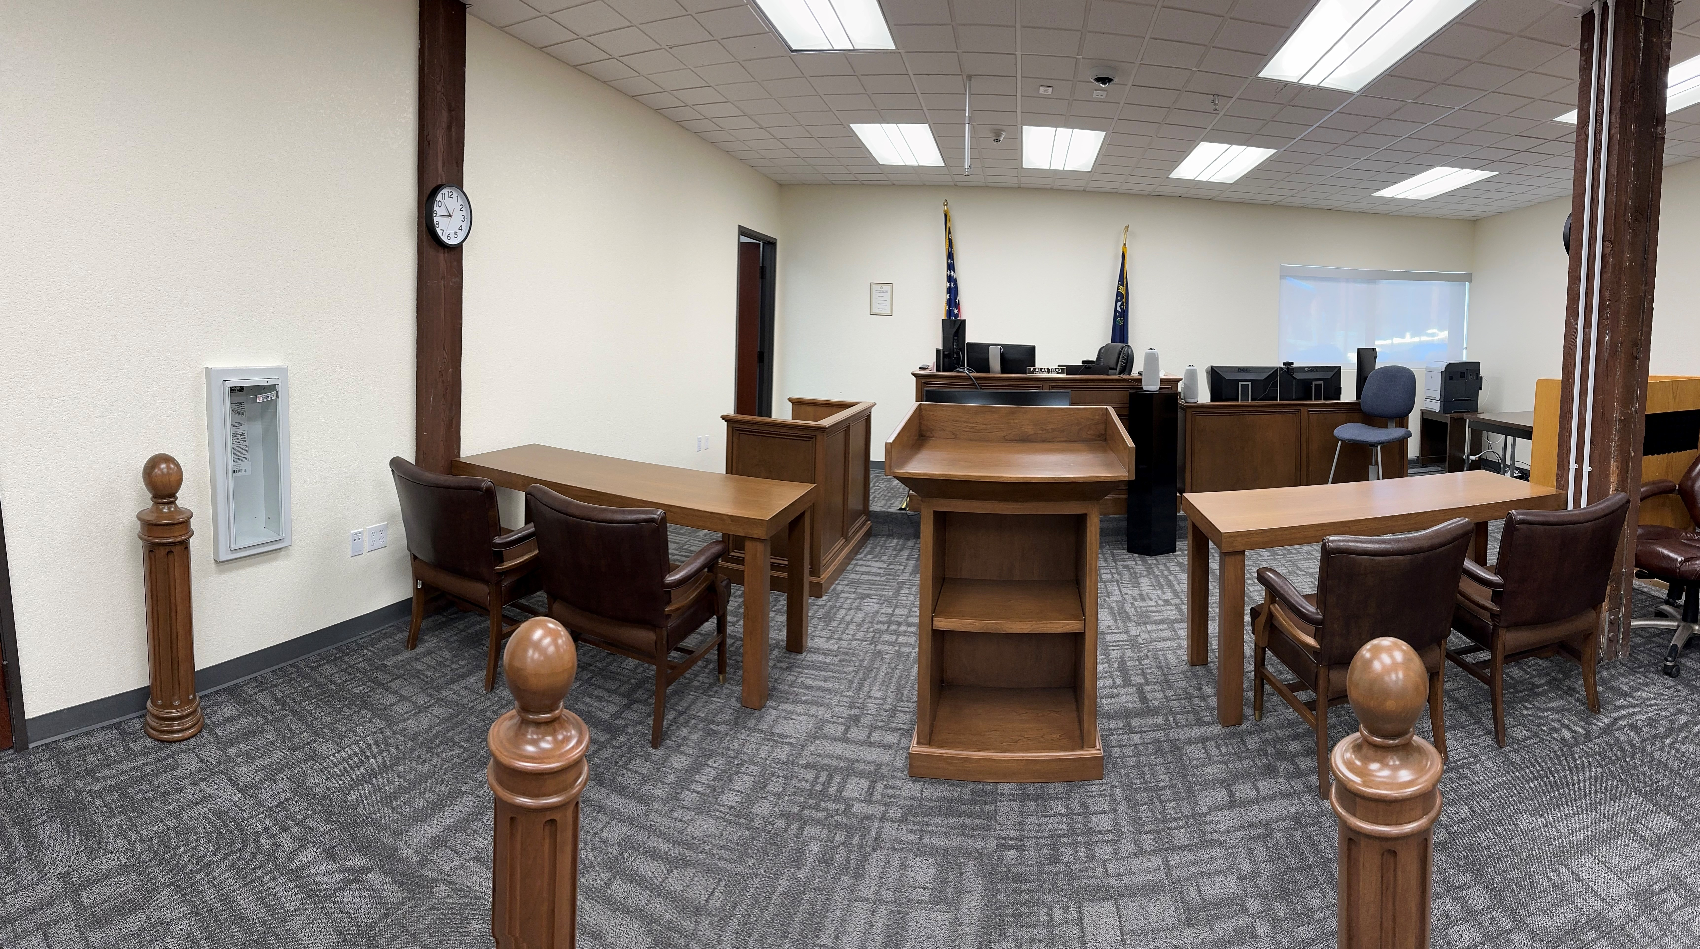
Relocated Incline Village Justice Court
Notes:
Narrate here – the "why" is critical.

Slide 10
Senior Services/Community Center Activities
Community Center Hours:
  Open Monday through Friday, 9 am to 5 pm
  Reservable space for group meetings
  Mahjong, Chess, and Bridge Groups
Improve/Expand Senior Services Programming:
  April: Time Out Tuesday, Bi-monthly hands-on craft activity
  May: Lifelong learning – weekly instructional program
Notes:
Narrate here – the "why" is critical.

Slide 11
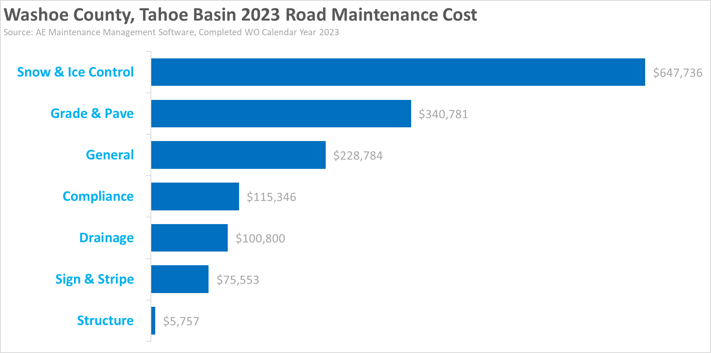
Roads and Highways
Open Monday thru Friday 9 am to 5 pm
Notes:
Narrate here – the "why" is critical.

Slide 12
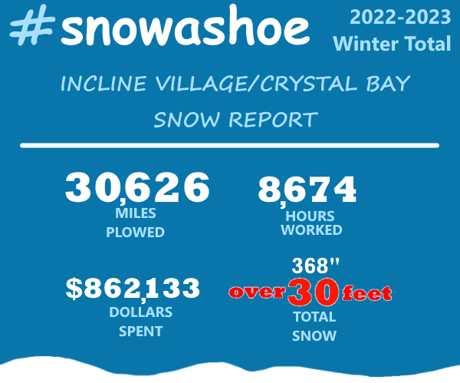
Roads and Highways
Notes:
Narrate here – the "why" is critical.

Slide 13
Roads and Highways
Installation of 8 radar feedback signs: ($30K)
  Lakeshore Blvd
  Country Club
  Southwood
Right of way improvements: ($3.1 million)
  Southwood
  Mays
  Freels Peak for stormwater conveyance into Lower Wood Creek
Notes:
Narrate here – the "why" is critical.

Slide 14
WTHP Roadmap
Tahoe Area Plan (TAP) amendment has been prioritized by the BCC
Staff currently working on 4 affordable housing packages and a public noticing code change
TAP amendments are expected to begin in late 2024 and will need to include TRPA affordable housing initiatives
Notes:
Narrate here – the "why" is critical.

Slide 15
Additional Planning Resources
Planning Manager – Long-term planning Countywide, including Tahoe Area Plan amendments
Assistant Planner – Assist the Planning Manager with long range planning
Communications Specialist – Focus on CAB’s, and development activity in communities like Incline Village
Notes:
Narrate here – the "why" is critical.

Slide 16


Evacuations
OCTOBER
2023
UPDATES

Slide 17
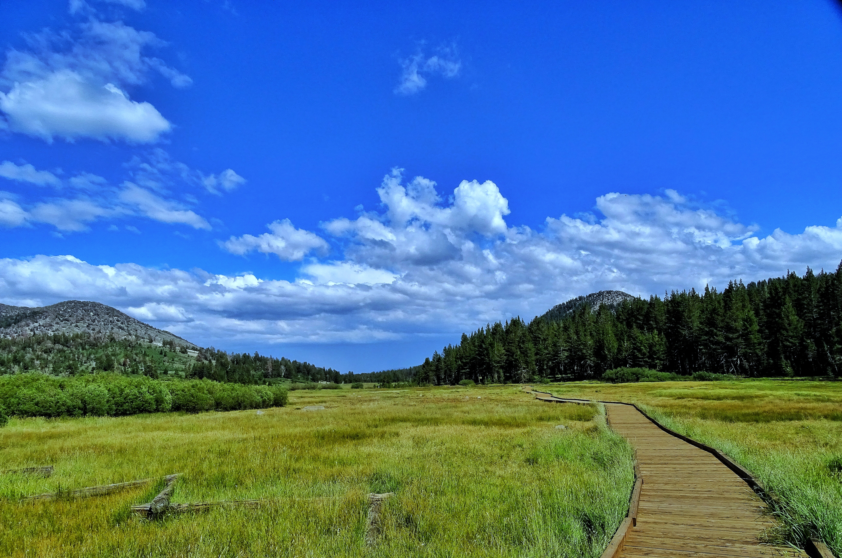
The Year Ahead
2024

Slide 18
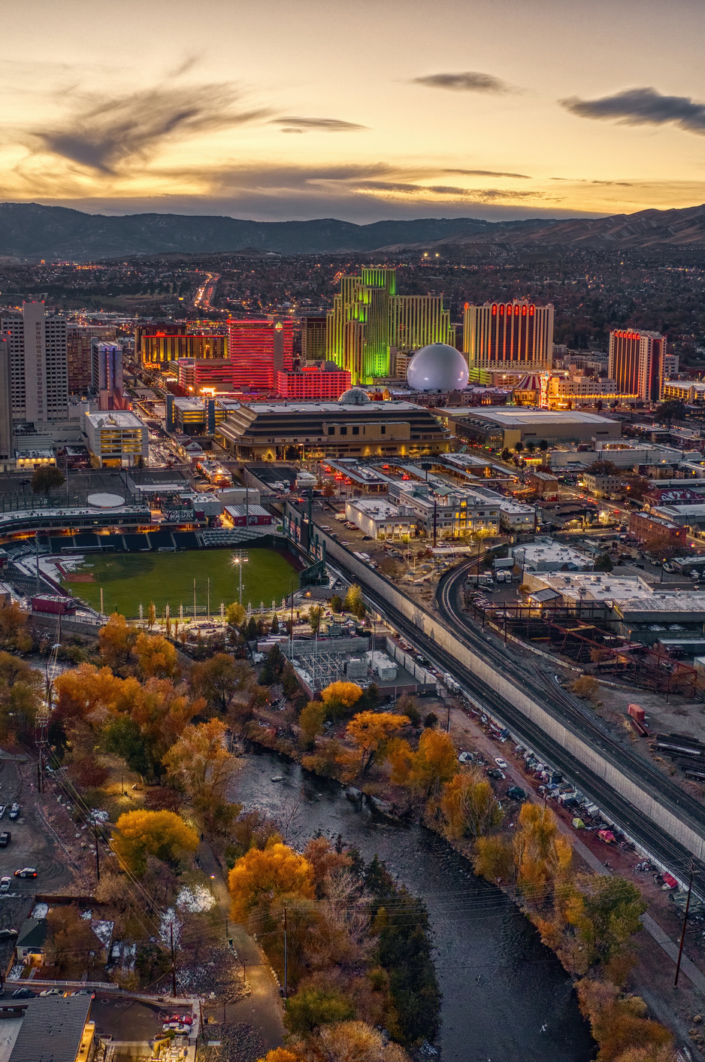
2024 Key Goals
Implement regionalized Dispatch/EMS/Fire Services
Complete West Hills refurbishment and open the facility for mental health services
Expand and improve senior services and facilities
Upgrade of our election infrastructure, processes and staffing in preparation of 2024 elections
Establish sustainability plan priorities to achieve 2025 and 2035 milestones
Identify a new Reno Courthouse solution
Develop Funding Plan for WCSO Infirmary

Slide 19
Thank you!

